Slide 1

Autonomous Systems
Drone + Markers + EKF Localization
Group:
Sara Sequeira, 76258
Tiago Valentim, 78400
Marina Moreira, 78460
Sofia Fernandes, 78563
2017/2018
Faculty: Pedro Lima, Rodrigo Ventura, Oscar Lima

Slide 2
Presentation topics
ROS final schematic (node schematic and topic schematic)
Ar_track_alvar considerations
Kalman Filtering
State Matrix Definition
Observation Matrix Definition
Sensor Covariance Matrices Definition
Kalman Prediction Step
Kalman Matching Step
Kalman Update Step
Profiling the Code
Visualizing data
Result Analysis
Conclusions & Future work

Slide 3
ROS final schematic
Fixed tf broadcaster
\tf
\tf
Invert marker
\tf
Rviz
\image_raw
\camera_info
Recording
Tracker identification
\tf
Kalman
\tf
Error Visual
\crazyflie/imu
\crazyflie/pressure
\error_msg

Slide 4
Ar_track_alvar considerations
Beginning of flight:
\image_raw
Calibration
Tracker identification:
\ar_track_alvar
\camera_info
ar_track_alvar parameters:
max_new_marker_error = 0.08
max_track_error = 0.08

Slide 5
Extended Kalman Filtering
Prediction
Matching
Update

Slide 6
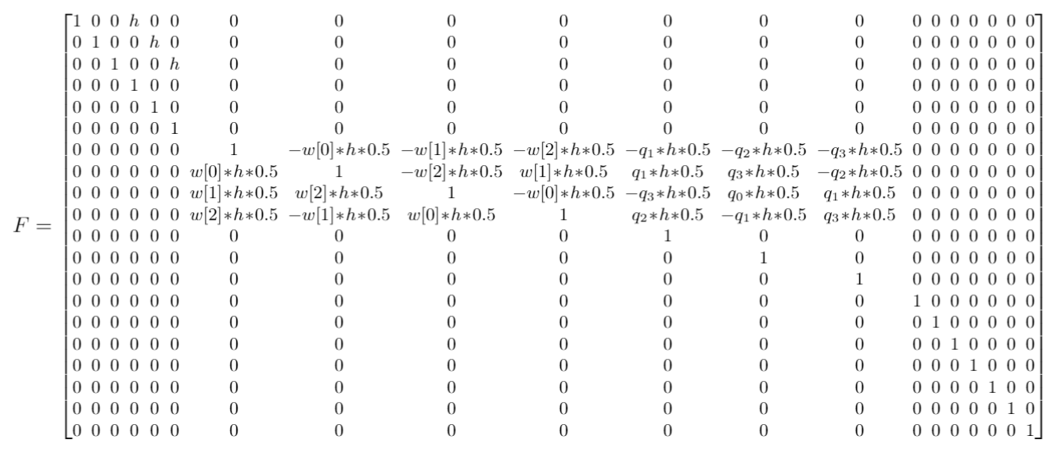
State Matrix Definition
Extended Kalman Filtering
X[k+1] = f(X[k])
Q ~N
For the covariance calculation F was used

Slide 7
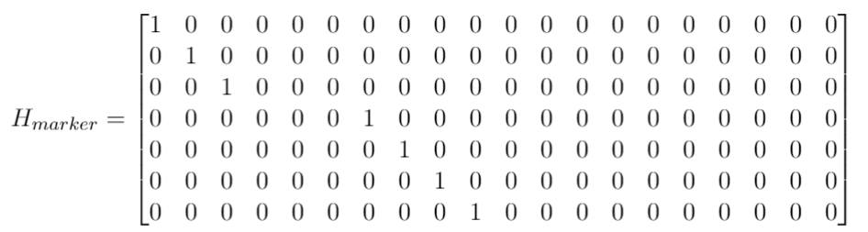
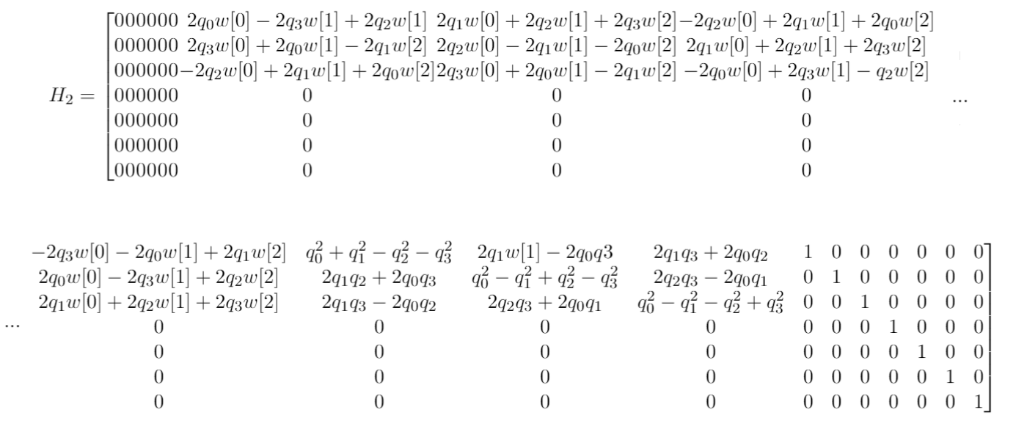
Observation Matrix Definition
Extended Kalman Filtering
Z = h(X[k]) + R
R ~ N
For the state calculation the following H matrix was used

Slide 8
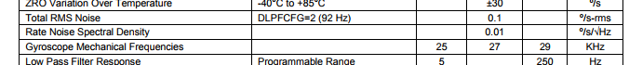
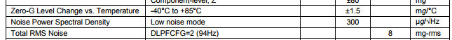
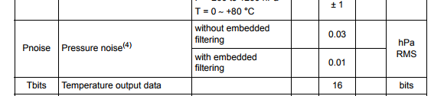
Covariance Matrix Definition - IMU
Extended Kalman Filtering
Assuming Independent Noise→ Diagonal Matrices
Data from IMU provider - MPU-9250:
Data from pressure sensor - LPS25H:
Gyro:
Acc:
As values from sensor provider did not yield good results when integrating, values were adjusted

Slide 9
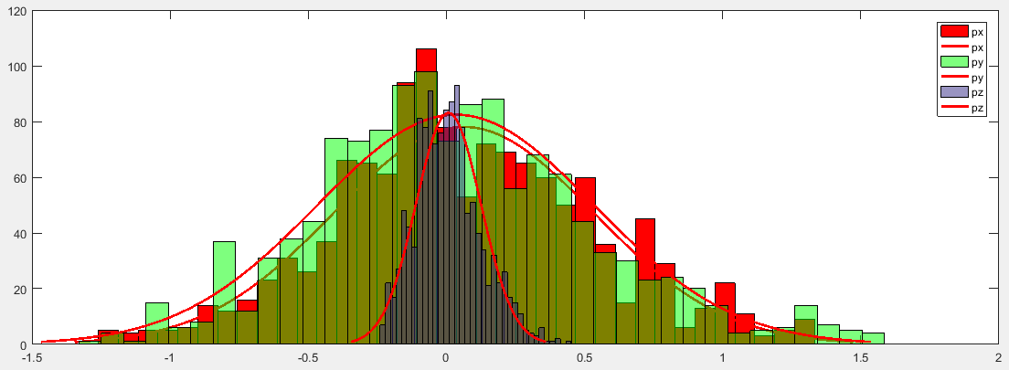
Covariance Matrix Definition - Markers
Extended Kalman Filtering
Position Error:
Assuming Independent Noise
Idea: Plot from ground truth to marker error → plot gaussian distribution
Problem: We are assuming the Optitrack’s ground truth is perfect

Slide 10
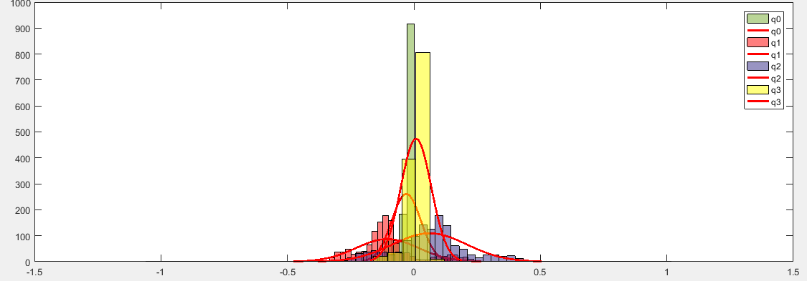
Covariance Matrix Definition - Markers
Extended Kalman Filtering
Attitude Error:
Not Assuming Independent Noise in Quaternions
Idea: Plot from ground truth to marker error → plot gaussian distribution
Problem: We are assuming the Optitrack’s ground truth is perfect

Slide 11
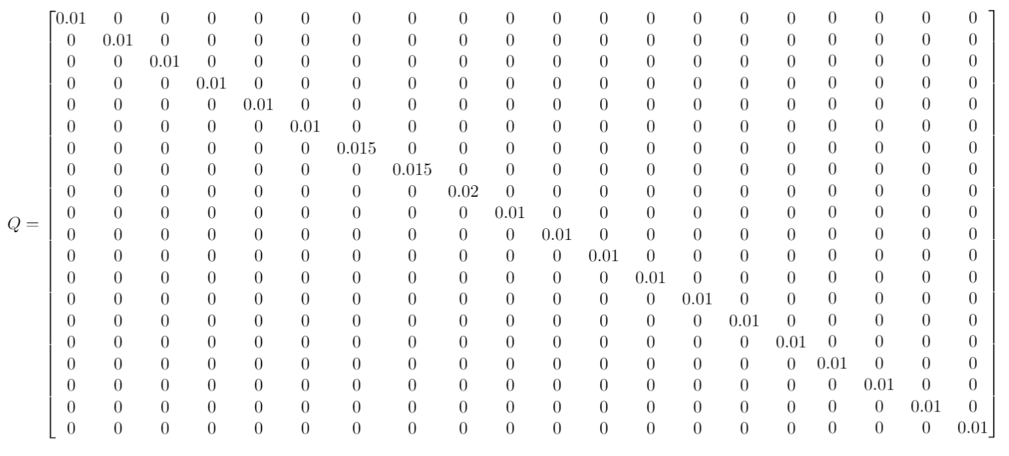
Covariance Matrix Definition - Final
Extended Kalman Filtering

Slide 12
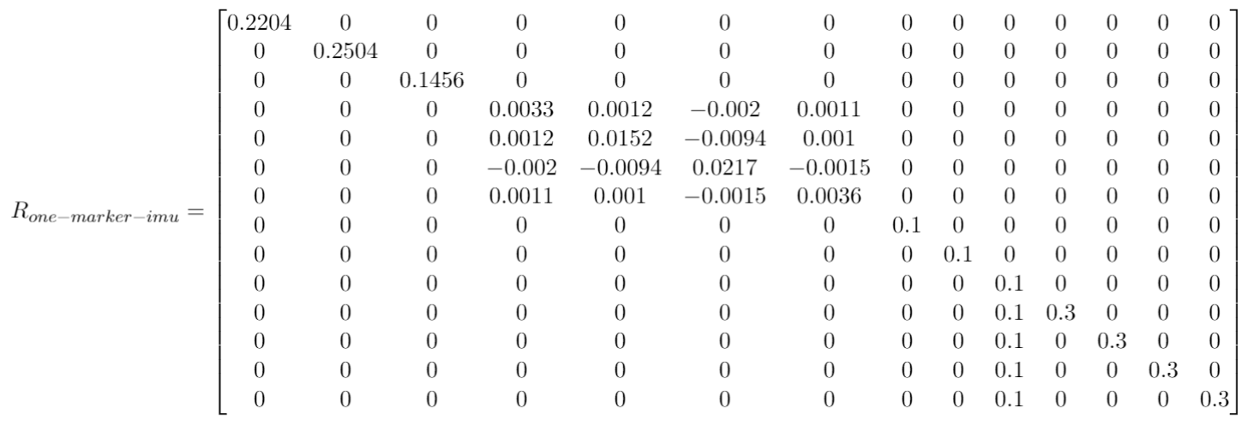
Covariance Matrix Definition - Final
Extended Kalman Filtering

Slide 13
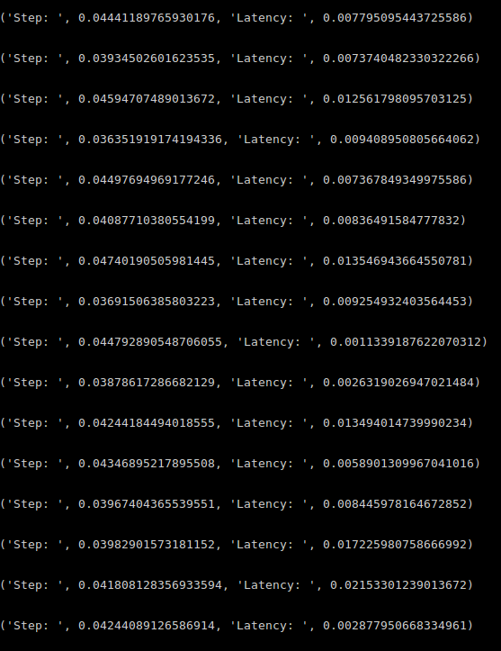
Profiling the Code:
Extended Kalman Filtering
Note:
To spare time in Kalman calculation, we passed all the visualizing part to another process visio.py
(even though it is supposed to run in different thread)

Slide 14

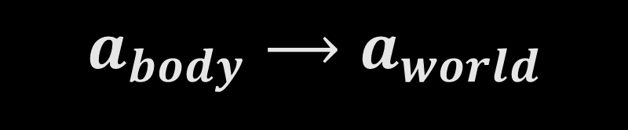


Extended Kalman Filtering
Using acceleration to estimate altitude bias
$$a_{body}⟶a_{world}$$
1st Step:
$$a_{x_{w}}≈sen(θ)⟶θ$$
2nd Step:
$$a_{y_{w}}≈sen(φ)⟶φ$$
3rd Step:
$${θ_{acc},φ}_{acc},ψ_{pred}⟶q_{0_{acc}}, q_{1_{acc}}, q_{2_{acc}}, q_{3_{acc}}$$
4th Step Update Step Kalman:
$${q_{i}}_{bias}=\left(\frac{{{q_{i}}_{prediction}−q}_{i_{acc}}}{C_{1}}\right)+{q_{i}}_{bias}$$

Slide 15
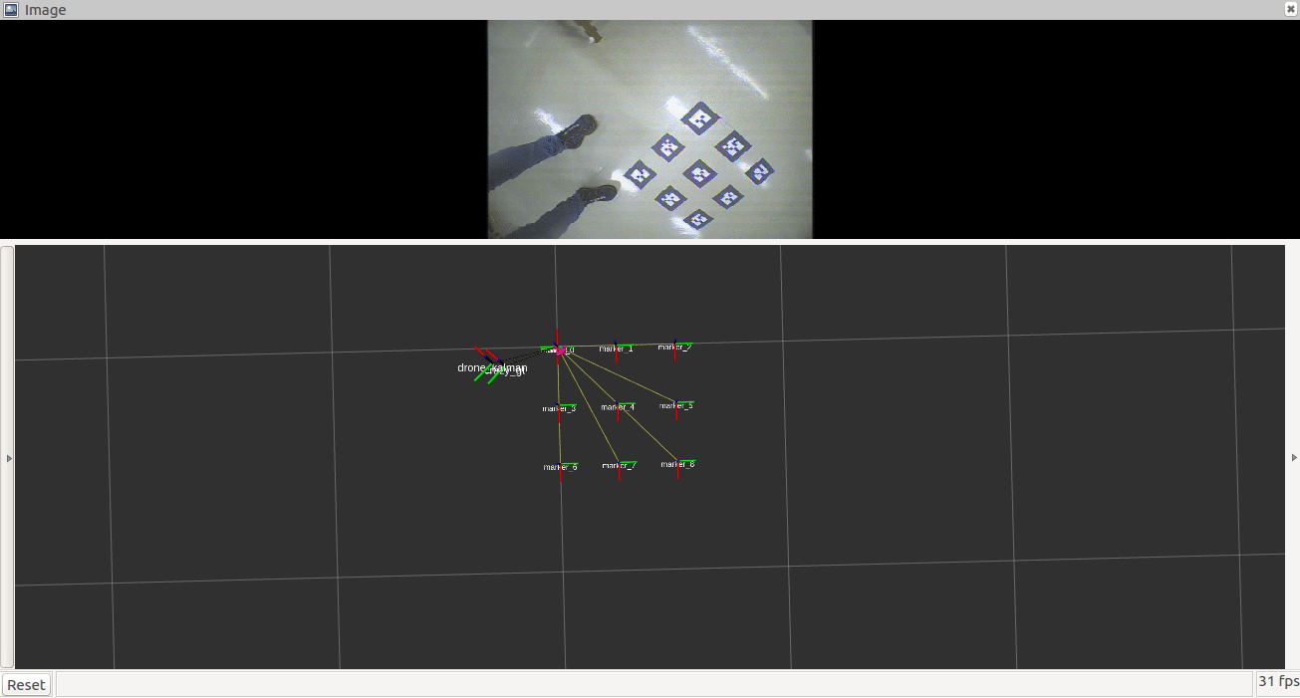
Extended Kalman Filtering
Using acceleration to estimate altitude bias
Results:

Slide 16
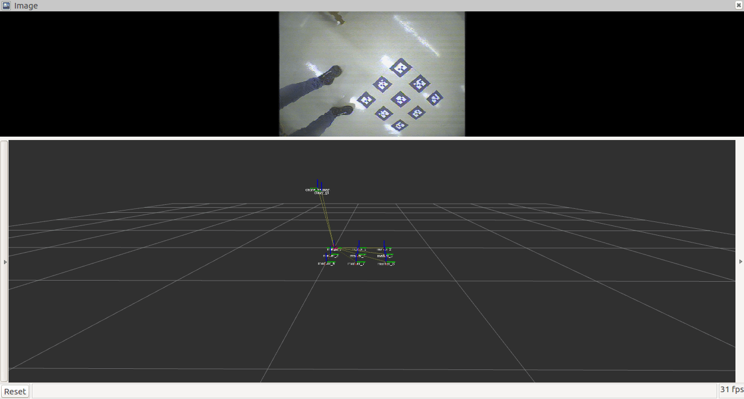
Extended Kalman Filtering
Using acceleration to estimate altitude bias
Results:

Slide 17

Using pressure to estimate altitude
Extended Kalman Filtering
1st bag
5th bag
Calculated correlation bag junction:
3rd bag
7th bag
$$\left[\begin{aligned}1.0000 −0.6819 \\ −0.6819 1.0000\end{aligned}\right]$$

Slide 18
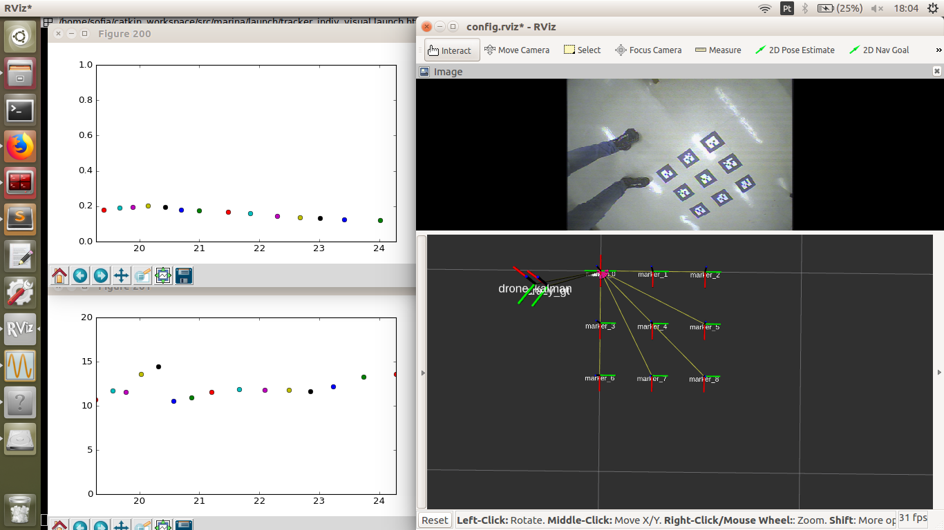
Visualizing data

Slide 19
Result Analysis

Slide 20
Conclusions & Future work

